Slide 1
Short Course in Linguistics
Language Change and Evolution

Slide 2
Topics
Phonetics and Phonology
Morphology
Syntax
Language Change
Identity

Slide 3
How do we get from...
Hwæt. We Gardena in geardagum,
þeodcyninga, þrym gefrunon,
hu ða æþelingas ellen fremedon.
Notes:
https://youtu.be/_K13GJkGvDw

Slide 4
To this...
A knyght ther was, and that a worthy man,
That fro the tyme that he first bigan
To riden out, he loved chivalrie,
Trouthe and honour, fredom and curteisie.
Ful worthy was he in his lordes were,
And therto hadde he riden, no man ferre,
As wel in cristendom as in hethenesse,
And evere honoured for his worthynesse.

Slide 5
To....
LO, praise of the prowess of people-kings
of spear-armed Danes, in days long sped,
we have heard, and what honor the athelings won!

Slide 6
Some reminders from the first week...
Languages are extremely diverse
Over 7000 languages worldwide
No person ever has full mastery of the language they use
Most people in the world speak more than one language
43% bilingual
13% trilingual
3% quadrilingual
1% are polyglots...

Slide 7
And a couple more...
Complex, mutually agreed system for linking form to meaning
We use language to relay information about events and social relationships
Constantly changing
Sounds change
Words change
Syntax changes
Semantics change

Slide 8
Some things are resistant to change
Words like:
back (Old English bæc)
become (Old English becuman)
day (Old English dæg)
blood (Old English blōd)

Slide 9
Some things aren’t...
Pretty much anything can change
What changes depends on a number of factors
Environmental factors
Social factors
Political factors

Slide 10
Environmental factors
A range of environmental factors can lead to changes in our speech
Hypotheses around why tonal languages are centred around the equator (not so much about language change but about finding language external reasons for differences)
The bilabial fricative changing into a labiodental fricative due to diet

Slide 11
Environmental Factors
Language is a complex ecosystem
A change in one place has flow on effects to other linguistic layers
A change from ɸ to f changes the rules for how words are formed
This could create ambiguity
Which in turn starts changing syntax and semantics

Slide 12
Social Factors
Language relies on inter-generational transfer
The level of mastery of the parent affects the level of mastery of the child (initially)
The accent of the child’s friends affect the accent of the child
Why?

Slide 13
Social Factors
Language is used to indicate social relationships
We unconsciously (mostly) modify our language to the situations we find ourselves in
Children are under pressure to communicate like their peers from a very early age

Slide 14
Social factors
The types of things that social factors can influence are:
Pronunciation (‘g’ dropping in English ‘-ing’ verbs)
Word choice (domain specific)
Grammatical structures (Star Wars fans quoting Yoda)

Slide 15
Social factors
This type of change is extremely important
Gives us a view of how languages are related
Allows us to understand the history of languages and populations

Slide 16

Social factors
Language change starts as variation amongst speakers
Over time one variant becomes more prominent and eventually replaces the other
This type of language change is largely opaque to users and takes place over very long periods of time

Slide 17
Historical Linguistics
Historical linguistics focusses predominantly on these types of internal changes
By using the comparative method, linguists are able to hypothesise earlier states of language
The comparative method takes lists of ‘cognate’ words (words that have the same meaning) and using principles of common sound changes can reconstruct ‘proto-langauges’

Slide 18
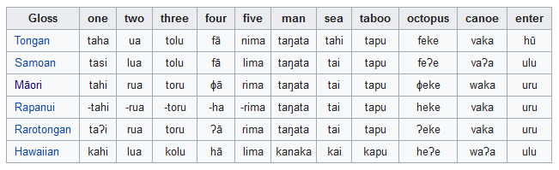
Notes:
Do example on board for this.....

Slide 19
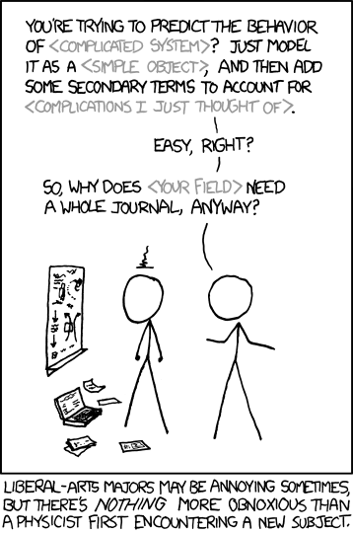

Slide 20
Computational historical linguistics
Starting to use more sophisticated methods to understand the history of language
Bayesian methods from evolutionary biology being bought across into historical linguistics to allow for more data to be analysed
We’ll take a look at a quick case study

Slide 21
Phylogenetic methods
The data
 | taboo | blood | to suck | taboo | blood | to suck (1) | to suck (2)
Fijian | tabu | drā | sucu-ma | 1 | 0 | 0 | 0
Maori | tapu | toto | ngote | 1 | 1 | 1 | 0
Tahitian | tapu | toto | ote | 1 | 1 | 1 | 0
Marquesan | tapu | toto | omo | 1 | 1 | 0 | 1
Hawaiian | kapu | koko | omo | 1 | 1 | 0 | 1
Greenhill 2015
Notes:
And as described in Greenhill (2015), such data are analysed in terms of presence versus absence of each cognate set found within the language family
shown here with the Fijian and Polynesian data that Simon used in the article
A difference with these data from the data that we used for the Micronesian example, is that here we are looking at presence versus absence of a cognate, rather than presence of particular sound changes
but the principle is still the same – looking for historical relationships among languages through shared cognates

Slide 22
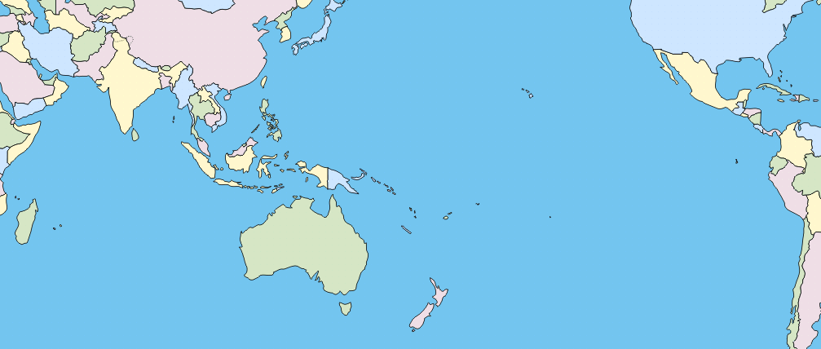
History through phylogenies
Population dispersals
Greenhill 2015; Gray et al. 2009
Notes:
The study described in Greenhill’s article is one that tested two hypotheses regarding the possible movements of people which has resulted in the geographical spread of contemporary Austronesian languages
Hypothesis 1 (red): is the generally accepted one, that the homeland of the Austronesian language family is in Taiwan
and that ancient Austronesian speakers moved southwards into the Phillippines, into Indonesian and eastwards into the Pacific
Hypothesis 2 (blue): is less well-accepted, and proposes that the homeland of Austronesian language family was in the region of Sulawesi and the Moluccas
and that ancient Austronesian speakers spread both northwards and eastwards from there

Slide 23
History through phylogenies
Population dispersals
Greenhill 2015; Gray et al. 2009; figure from Gray, Atkinson & Greenhill 2011
Notes:
Gray et al. (2009) used a Bayesian phylogeny of the Austronesian language family to test a number of different aspects of these two hypotheses about the dispersal of Austronesian speaking peoples
First, the phylogeny itself suggests a hierarchical structure such that the Austronesian family encompasses all languages within the region, while the next largest subgroup encompasses all Austronesian languages outside of Taiwan
we can see that this nested structure patterns in a way that suggests the south, then eastwards dispersal of people – i.e. a chainlike pattern rather than a two-pronged expansion (Greenhill 2015:373)

Slide 24
History through phylogenies
Population dispersals
Greenhill 2015; Gray et al. 2009; figure from Gray, Atkinson & Greenhill 2011
Notes:
Second, these two hypotheses point to different timings of the Austronesian expansion
Hypothesis 2 – the Wallacea hypothesis – argues that the An expansion was triggered by the rising sea level at the end of the last Ice Age (c. 13,000 – 15,000 BP) and reflects the expansion of an ancient network of maritime exchange
Hypothesis 1 – out of Taiwan – argues that the An expansion was much later and connected with a cultural complex in Taiwan that can be dated to about 5,500 BP
Gray et al. estimated the age of the Austronesian by adding robust archaeological dates to the phylogeny at several points – these include dates of first settlement dates, and also links made between particular archaeological cultural complexes and Austronesian languages, like the 3,500 BP for Oceanic
then estimated dates of other nodes in the phylogeny are calculated using mathematic models that use the observed rates of change in the cognate sets and assume a non-constant rate of change across the phylogeny
this method points to the younger date for the An expansion

Slide 25
History through phylogenies
Population dispersals
Greenhill 2015; Gray et al. 2009; figure from Gray, Atkinson & Greenhill 2011
Notes:
Third, the branch lengths in such a phylogeny, which are relative to the amount of change can be argued to reflect the nature of the population movement
that is, if there is a population expansion, we would expect to see in the short branches in the tree reflecting the fact that there was little time for change to spread throughout the speech community before its diversification
long branch lengths, in contrast, would reflect pauses in expansion, when there was time for changes to spread throughout the speech community before it was broken up by further expansions
There are two such “pauses” that look to be reflected in this phylogeny
settlement of the Philippines, and the PMP speech community
in western Polynesia before continued expansion into central and eastern Polynesia, as described in the reading for last week’s tutorial
This pause-pulse model of population dispersal is predicted in the “out of Taiwan” model, but not in the “Wallacea” model, which predicts a slow and gradual expansion of people

Slide 26
History through phylogenies
Population dispersals
Greenhill 2015; Gray et al. 2009
Notes:
So these phylogenetic methods provide support for the hypothesis that the Austronesian language family reflects expansion from a homeland in Taiwan about 5,500 years ago
and that this expansion was mostly fairly rapid, with two major pauses

Slide 27
But not all changes are internal...
Language contact is a big driver of language change

